Slide 1

Topic:
Transforming Voice Prompts into Visual Creations using Transformers
Team Name:
Speak scene

Slide 2

INTRODUCTION
AI advancements enable seamless transformation of voice prompts into images. Utilizes speech recognition, NLP, and image generation models.

Slide 3

PROBLEM STATEMENT
Traditional image creation requires manual input and artistic skills.
Need for an automated and AI-driven approach for accessibility and efficiency..

Slide 4
Our Solution
Uses OpenAI Whisper for speech-to-text conversion.
Employs GPT-3.5 Turbo for text summarization and prompt optimization.
Leverages DALL·E 2 to generate high-quality images from refined prompts.

Slide 5
Technology Stack
Speech Recognition: OpenAI Whisper, speech_recognition Python library.
Text Processing & Summarization: OpenAI GPT-3.5 Turbo.
Image Generation: OpenAI DALL·E 2.
Interface: Gradio for seamless interaction.- *Backend & Deployment:* Python, Flask/FastAPI.

Slide 6
How It Works
User speaks into the microphone– Audio input is captured.
Whisper AI transcribes the speech – Converts spoken words into text.
GPT-3.5 refines the text – Summarizes and optimizes for DALL·E.
DALL·E generates an image – Transforms the text prompt into visuals.
User receives transcription and generated image – Output displayed in a user-friendly interface.

Slide 7
Code Overview
Speech-to-Text: whisper_transcribe(audio)
Text Summarization: chatgpt_api(input_text)
Image Generation: dall_e_api(dalle_prompt)-
Gradio Interface: gr.Interface(...)

Slide 8
Features & Benefits
Automated Speech-to-Image Pipeline – No manual input required.
Fast & Efficient – Real-time processing.
High Accuracy – Advanced AI models ensure precise transcription and image relevance.
User-Friendly Interface – Intuitive design with Gradio.
Scalability – Can be extended for multiple use cases.

Slide 9
Use Cases
Education – Assist students in learning through visual representation.
Content Creation – Auto-generate images for blogs, presentations, and videos.
Accessibility – Help visually impaired users interact with AI-driven visuals.
Entertainment – Generate concept art and design inspirations.

Slide 10
Future Enhancements
Live Transcription & Image Generation – Real-time visualization.
Integration with AR/VR – Create immersive AI-generated environments.
Customization Options – Allow users to fine-tune AI-generated images.
Mobile App Version – Bring the technology to a broader audience.

Slide 11
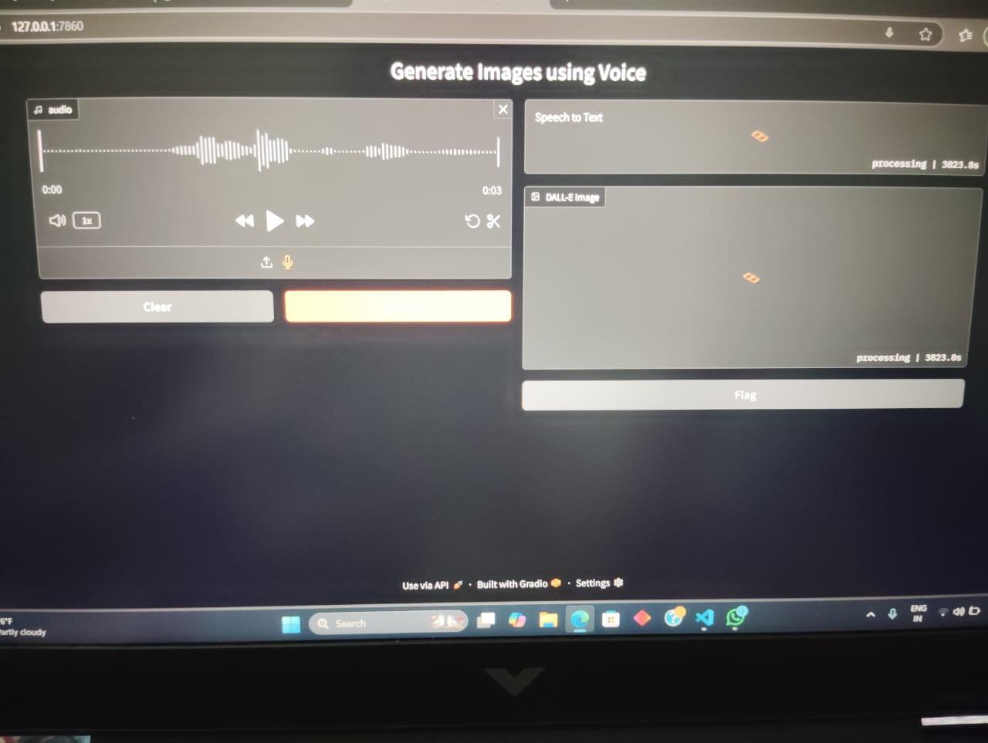
OUTPUT SCREEN

Slide 12
Conclusion
AI-driven speech-to-image transformation enhances creativity and accessibility. Leverages state-of-the-art AI models for high-quality output.Future developments will expand its applications across industries.

Slide 13
THANK YOU

